Slide 1

Varendra University
Dept. of Computer Science & Engineering (CSE)
Lab 7
Course Title: Microprocessor and Assembly Language Lab
Course No: CSE 334
Prepared By:
Md. Adnan Sami
Lecturer, Dept. of CSE, VU

Slide 2
Experiment Date: April 29, 2025
Experiment No: 07
Name of the Experiment:
Write some code in assembly language for displaying a row of 80 stars using EMU8086.
Write some code in assembly language for printing 5*5 matrix using EMU8086.
Write some code in assembly language, if AL contains 1 or 3, display "o"; if AL contains 2 or 4, display "e" using EMU8086.

Slide 3
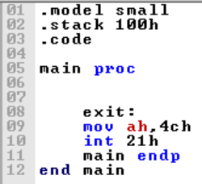
Return

Slide 4
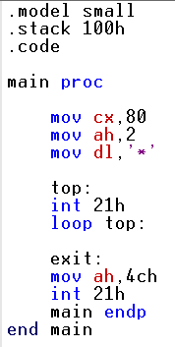
Write some code in assembly language for displaying a row of 80 stars using EMU8086.

Slide 5
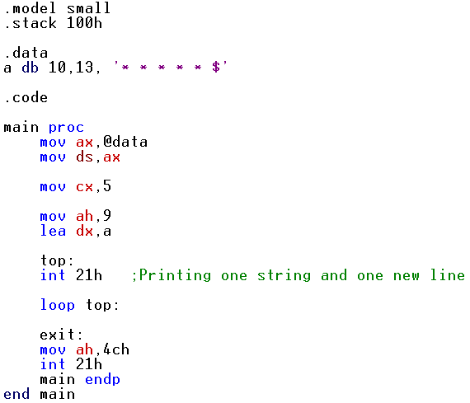
2. Write some code in assembly language for printing 5*5 matrix using EMU8086.
Notes:
s

Slide 6
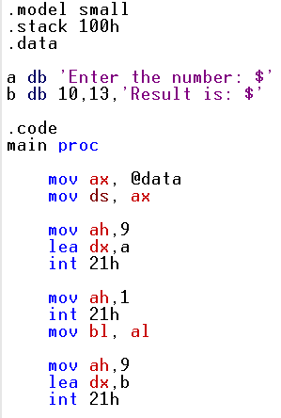
3. Write some code in assembly language, if AL contains 1 or 3, display "o"; if AL contains 2 or 4, display "e" using EMU8086.

Slide 7
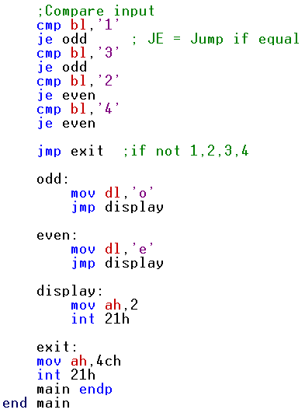
3. Write some code in assembly language, if AL contains 1 or 3, display "o"; if AL contains 2 or 4, display "e" using EMU8086.

